Slide 1
eBay website
UNDER GUIDANCE OF VAISHALI MAM

Slide 2
INTRODUCTION
eBay is a global e-commerce platform that allows users to buy and sell products.
Founded in 1995, it has become one of the largest online marketplaces worldwide
Purpose : To perform testing of ebay’s website functionalities using Selenium and TestNG.

Slide 3
OVERVIEW
eBay provides a wide range of products, including electronics, fashion and more.
Key Features tested :
User login and authentication
Product search
Adding/ removing items from cart
Updating user details
Product categories
Language Selection

Slide 4
Modules
Module 1 : Sign In Page
Checked all the functionalities on the Sign In Page which included:
Entering credentials
Validating login functionality
Verifying error messages for invalid credentials
Ensuring Forgot password links work properly
Module 2 : Search Functionality
Checked all functionalities related to product search which included :
Validating search results
Working of filter
Navigation of product pages from search
Module 3 : Cart Functions
Checked all functionalities related to cart which included :
Adding products to cart
Verifying product details in cart
Removing items from cart

Slide 5
Modules
Module 4 : Change Name
Checked all the functionalities on the updating user name which included:
Editing first , last names in the profile
Verifying that updated name is saved successfully
It should reflect the updated data
Module 5 : Change Address
Checked all functionalities related to updating the address which included :
Updating address fields in the profile
Verifying changes are saved
It should reflect the updated data
Module 6: Category Page
Checked all functionalities related to categories which included :
Checking every category
Verifying product under each category
Checking all available sub categories

Slide 6
Modules
Module 7 : Product Page
Checked all the functionalities on the product page which included:
Viewing product description and details
Item availability
Verifying add to cart functions
Module 8 : All Categories
Checked all functionalities related to all categories which included :
Checking all main and sub categories
Verifying products under each category
Module 9 : Language
Checked all functionalities related to language which included :
Changing website language
Verifying language change

Slide 7
DEFECTS
A defect occurs when the actual result of a test case does not match the expected result. So created defect report on it.

Slide 8
Defect identifier | Def_ebay_001
Defect summary | Expected result=options should change language appear in both desktop and mobile Actual Result = there is no option in mobile
Test Id | TC_016
Test case name | TC_Language_02
Module name | Language Change
Reproducible | 1.Open eBay on desktop browser , option to change site/language visible. 2. Open eBay on mobile browser , option not visible.
Severity | Medium
Priority | Medium
Raised by | Devendra(Tester name)
Assigned to | Reeva Shah(TL name)
Date of assignment | 18-08-2025
Status | open
Snap shots
Fixed by | Shiva Upadhyay(Developer name
Date of fixing=
Approvals=manager name | Nisha mandot(Manager name)

Slide 9
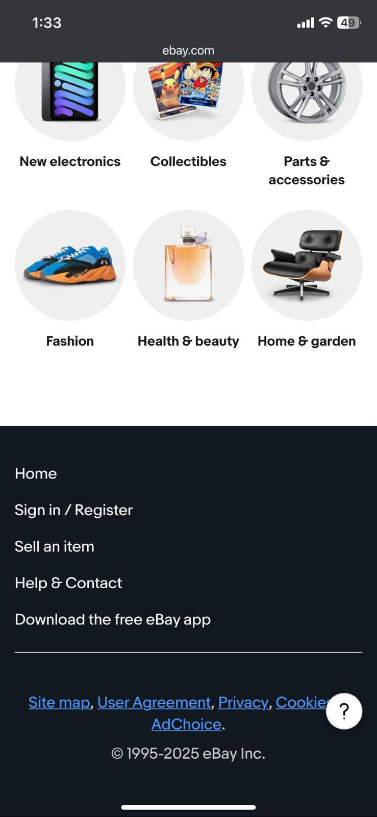
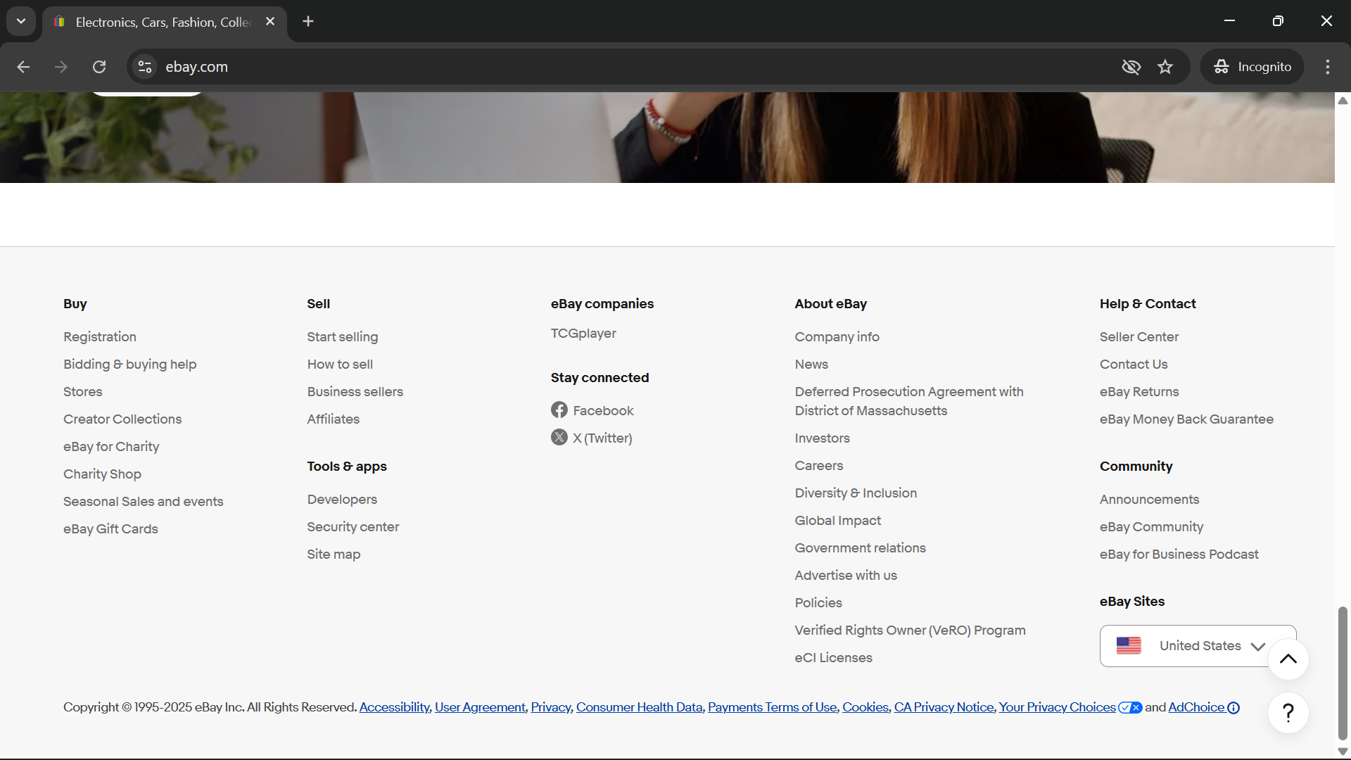

Slide 10
CHALLENGES
Handling Exceptions like Element Not Interactable, Not Clickable
Managing dependencies between test cases like login -> changename

Slide 11
EXPERIENCE
Gained hands on experience in automating web applications using Selenium WebDriver and TestNG.
Got to know how to handle waits and priorities
Understood real time challenges of web testing such as element visibility
Improved debugging skills
Understanding of e-commerce flow

Slide 12
THANK YOU

